Slide 1


Food Saver App
Project Managers: Furqaan Hyath, Tanjina Salam
Scrum Master: Ilka Jean
Programmers: Nagaraj Bhagwat, Japnit Singh Chawla

Slide 2

Product's purpose and target users
To distribute quality foods from "givers" which can include grocery stores to users of the application
Aims to reduce food wastage by letting users of the application find a donator of food that is close in proximity to them
Target users of the application includes anyone who is trying to find a place that is distributing food nearby

Slide 3

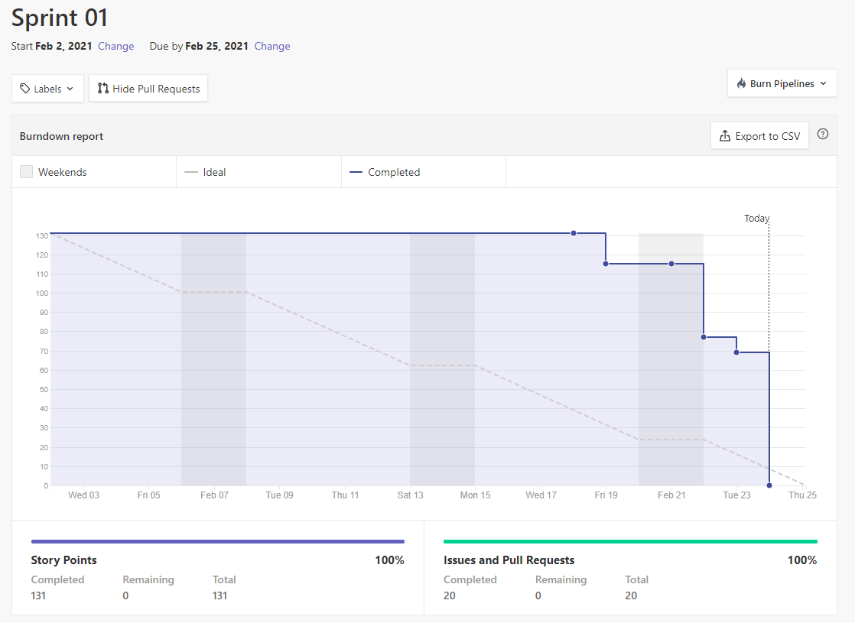
Burn down chart

Slide 4
METRIC: Point System
EPICS | POINTS | REASON
Conceptual Model | 18 | Understanding exactly what is a conceptual model? Collaborating to create one.
SDK & Emulator | 16
Choosing Database | 25 | Time and complexity
MAP API | 20 | Time and complexity
Functional vs. Non-functional | 8
PowerPoint | 21 | Time, summarizing all independent research.
Using points system allows us to more easily scale each epic based on difficulty and time needed to complete it.

Slide 5

Epics
Creating Conceptual Model
1
Selecting SDK and Android Emulator component that is compatible with Maps API
2
Choosing the right database
3
Selecting/Integrating a GPS Mapping API
4
Functional and Nonfunctional Features of the application
6
Creating Powerpoint

Slide 6
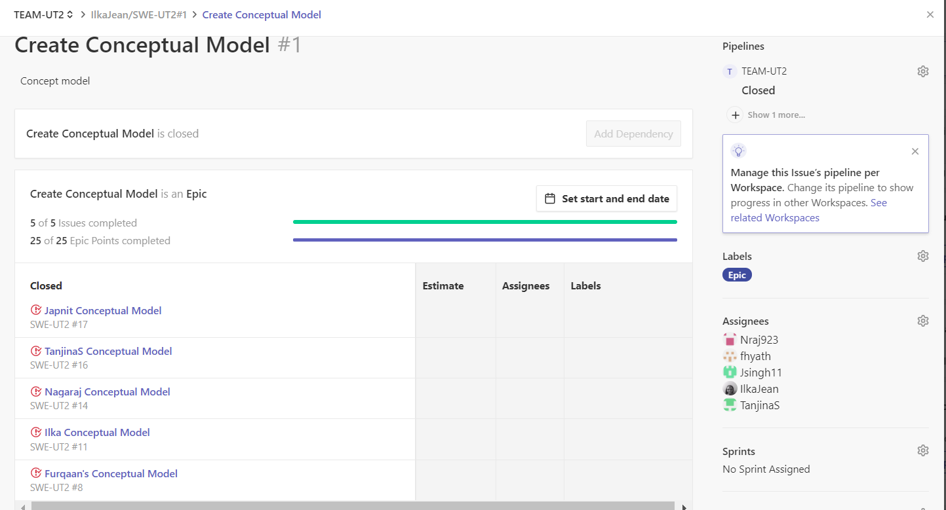
Epic 1: Conceptual Model
Think about the tools that are needed for our app
What the user will interact with
Individually create Conceptual Model
Choose one or collaborate on integrating the features from all

Slide 7
EPIC 2: R&D SDK & EMULATOR
When selecting an SDK, we have to consider the how many target users we want to target. Which SDK will best support the features and functionality of our application that.
When selecting an emulator, we have to consider the devices we want our application to run.

Slide 8

EPIC 3: R&D Database
What we considered when selecting a database:
Type of application we want to create
Size, the quantity of data we want to store
Structure, how we want to store and retrieve the data
Speed and scale, time it takes to service incoming reads and writes to your application

Slide 9
Epic 4: R&D MAP API
What we considered when selecting a MAP API:
Fast Digital Mapping Components:
Turn by turn navigation
Real Time Tracking
Routing
Number of app users
Ease of use for both developers and users

Slide 10
Epic 5: Functional vs Nonfunctional
Functional
Nonfunctional
Record user information into database
Validate user against database record for login
Software must integrate MAP API
Application should be portable
Users should be able to interact with application with ease

Slide 11
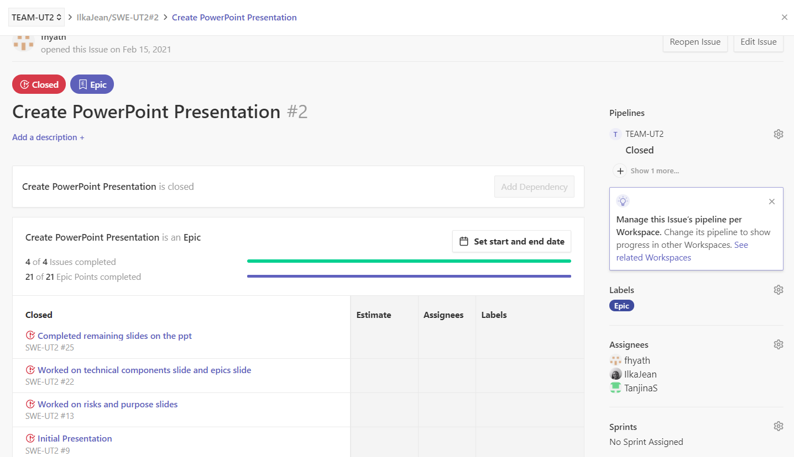
EPIC 6: POWERPOINT

Slide 12
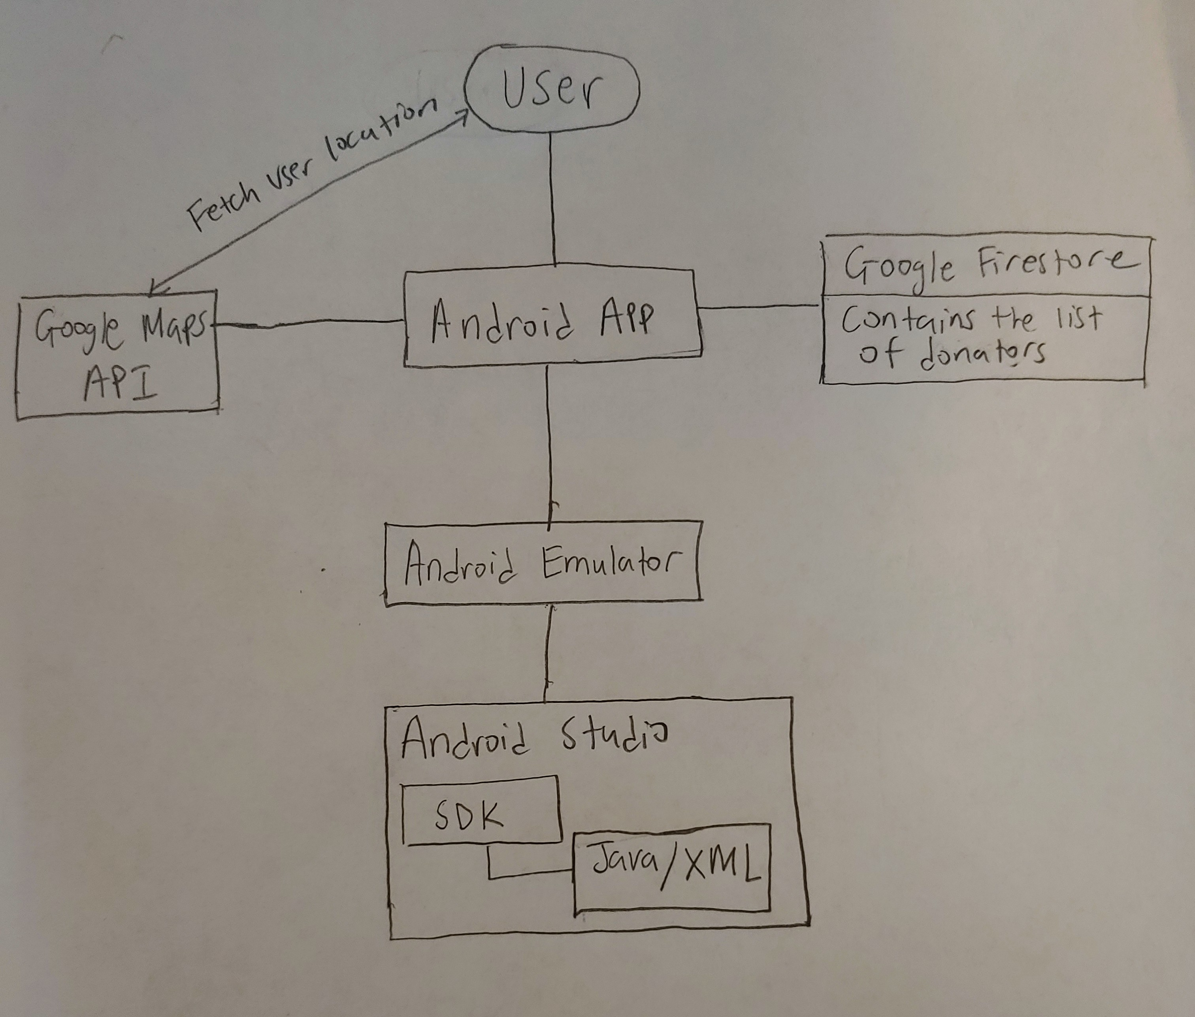
Conceptual Model

Slide 13


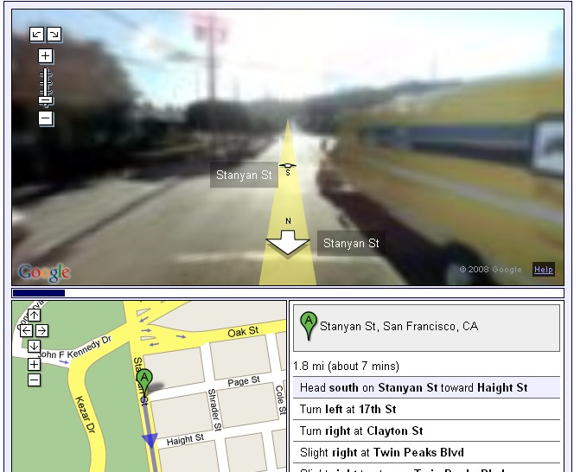
Technical components
Android Application
Marshmallow API Level 23
Pixel 3a API 27 Emulator
Google Maps API
Google Firestore
This Photo by Unknown author is licensed under CC BY-NC.
This Photo by Unknown author is licensed under CC BY-SA.

Slide 14
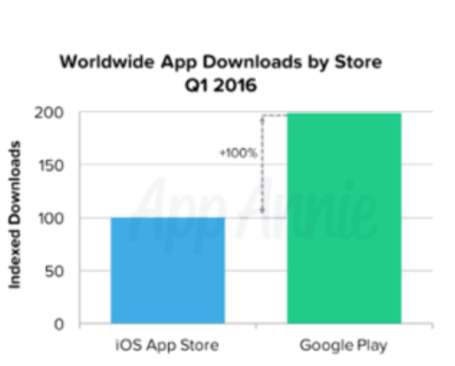
Why Android?
Open source
Allows for more flexibility with features
Goal of our app is to help fight against waste and hunger. Around 1.89 Billion people worldwide leave in poverty.
Android holds more a global target and helps us achieve our product purpose.

Slide 15
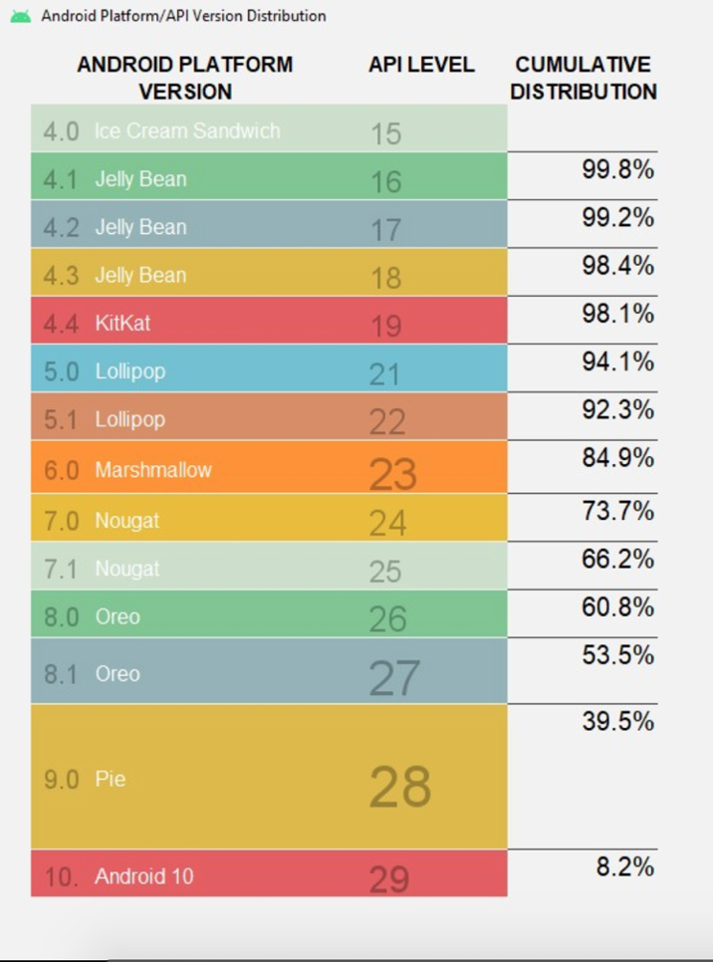
SDK: MARSHMALLOW API LEVEL 23
Able to integrate Google Maps API
Available on 84% of devices
Have newer and better features than those that are available on 90%+ Cumulative Distribution
Some examples:
Voice interactions: allows developers to build conversational voice experiences into apps
Assist API allows user to engage with app through an assistant

Slide 16
Using Android emulator is cost effective, allows us to test our application on multiple Android devices
Google Pixel 3a API considered to be one of the best android phones
Compatible with Marshmallow API
EMULATOR: Pixel 3a API 27

Slide 17

Why we chose Google Maps API
Cost-effective
Supports geolocation which allows application to determine physical coordinates
Useful classes and API calls such as distanceTo and Geocode which takes in an address and returns the latitudes and longitudes
More accurate than network location

Slide 18
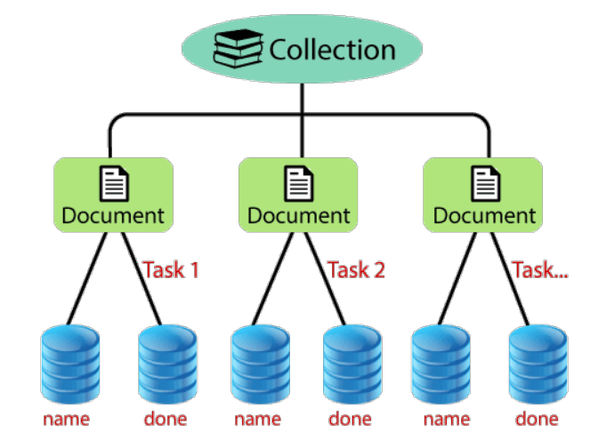
Google Firestore
Scalable, Cloud-based NoSQL database
Real-time updates and offline support
Schema is not rigid, thus allowing more flexibility

Slide 19
Risks discovered so far
Difficulties with setting up scheduled meeting times for all the members on the team
Understanding the scope of the project and knowing what is feasible to complete in a sprint
Getting used to the Scrum Agile methodology and learning the specific technologies included
Understanding the technical components needed for this application and how they will communicate with each other
Understanding the duties and responsibilities of each of the roles

Slide 20
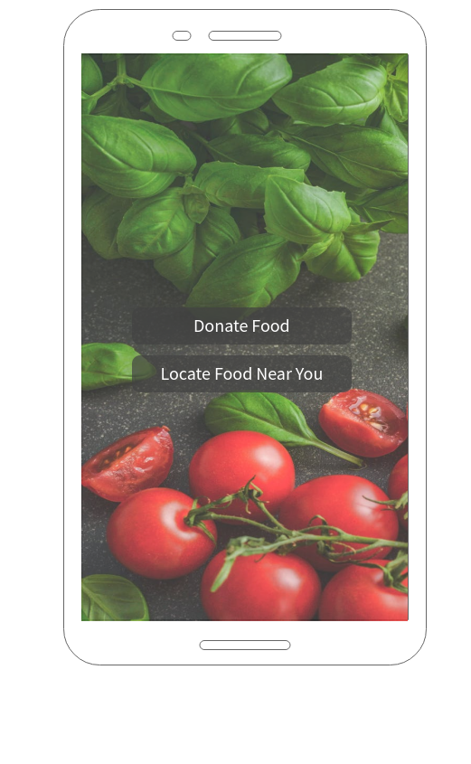
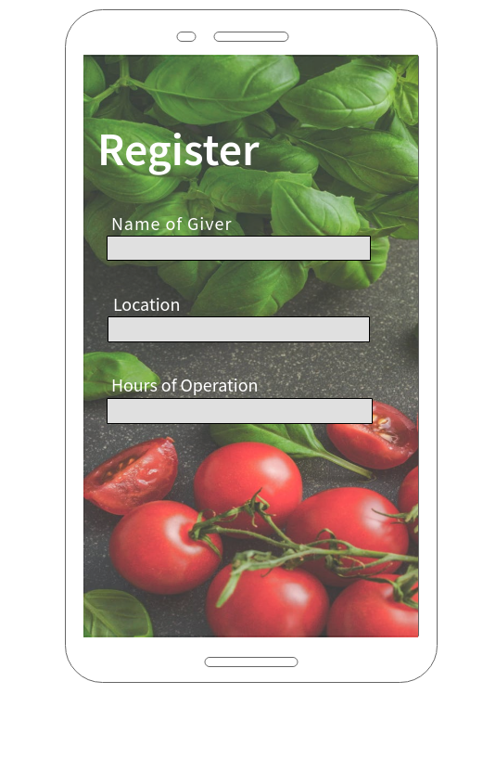
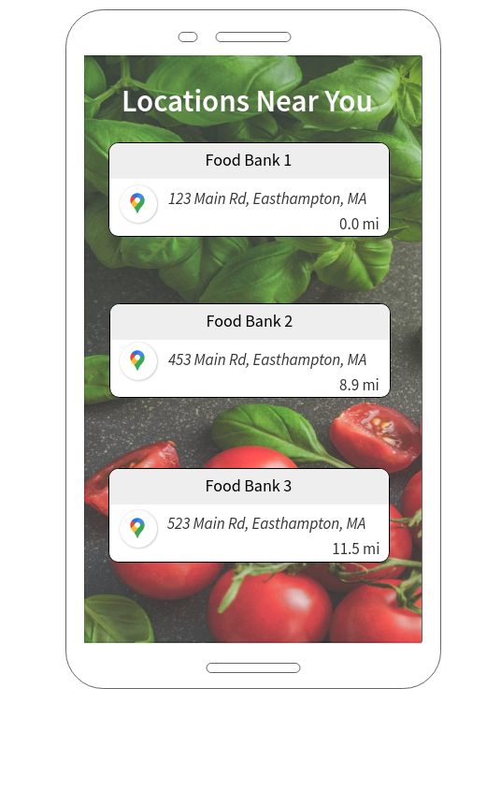
Wireframe

Slide 21

RESOURCES
https://medium.com/@the_manifest/android-vs-ios-which-platform-to-build-your-app-for-first-22ea8996abe1
https://www.guru99.com/functional-vs-non-functional-requirements.html
https://www.geeksforgeeks.org/functional-vs-non-functional-requirements/
https://firebase.google.com/docs/database/rtdb-vs-firestore
https://jungleworks.com/maps-api-mobile-app-guide-google-mapbox-openstreet-pricing/
https://developers.google.com/maps/documentation/android-sdk/overview
https://developer.android.com/about/versions/marshmallow
This Photo by Unknown author is licensed under CC BY-NC.

